Slide 1
Group H
Presented by: Roberto M. Jasmine M. Alec V. Avesta N.

Slide 2
Objective
The objective of this research is to comprehensively study the performance of SHA-2 and SHA-3 hash functions when implemented on various softcore processors. By benchmarking these cryptographic algorithms across diverse hardware configurations, we aim to provide insights into their computational efficiency and the interplay between different processors and cryptographic operations.

Slide 3
Hardware Used
Roberto Martinezcardozo’s Hardware
Desktop 1
CPU: Intel i7-9700 @ 3.0 GHz
RAM: 32 GB DDR4 2400 MHz
Raspberry Pi 4B
CPU: ARM Cortex-A72 @ 1.5 GHz
RAM: 4 GB LPDDR4 948 MHz
Laptop
CPU: Intel i7-11800H @ 2.30 GHz
RAM: 16 GB DDR4 3200 MHz
Alec Voong’s Hardware
Desktop 2
CPU: Intel i5-1035G7 @ 1.20 GHz
RAM: 8 GB 3733 MHz
Jasmine Mirbasoo’s Hardware:
Desktop 4
CPU: Intel i7-1165G7 @ 2.80GHz
RAM: 16 GB
Avesta Najaf’s Hardware
Desktop 3
CPU: Intel i9-12900K @ 3.20 GHz
RAM: 32 GB DDR5 5200MHz

Slide 4
Background

Slide 5
What is SHA?
A one way hashing algorithm that takes in a message and encrypts it
Used to perform data verification, create digital signatures, act as a password storage
First developed by the National Institute of Standards and Technology
The length of the block size determines the complexity of the hash value
EX: SHA-1, SHA-2, SHA-256, etc…

Slide 6
How does SHA work?
Padding - one “1” bit is added to the end of the message followed by “0”s until it reaches the block size
Dividing into blocks - the full message with padding is divided into blocks equal to the block size
Initializing hash buffer - a n-bit buffer is created to be used in processing the message blocks
Combining process - the message block and the initializing buffer registers are processed using arithmetic and logical operations

Slide 7
Results and analysis

Slide 8
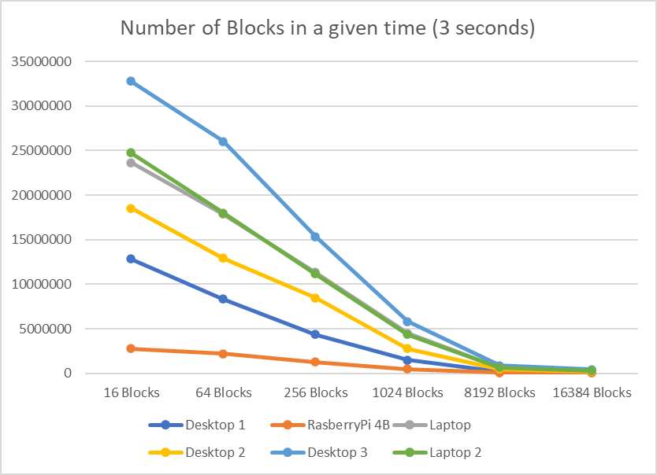
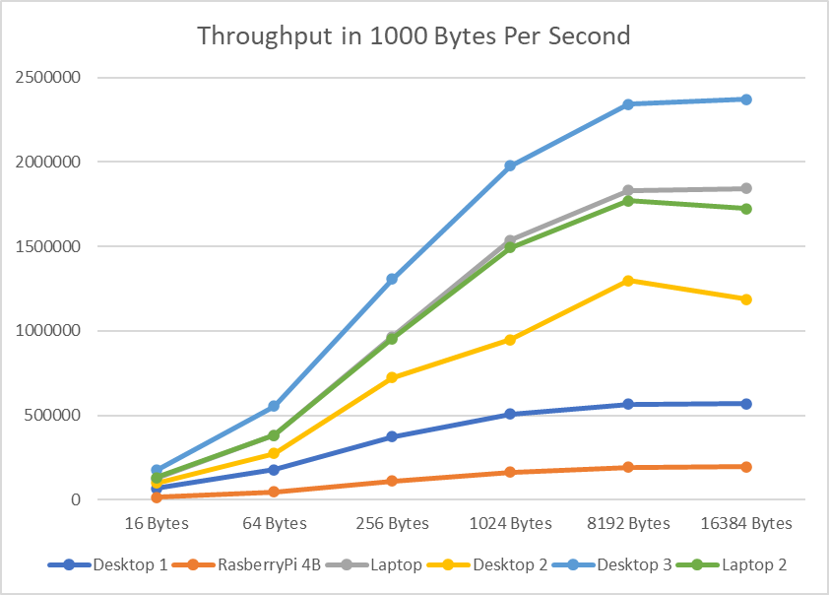
SHA2-256
Highest Performing Processor: Intel i9
Lowest Performing Processor: Raspberry Pi 4 Model B
Built to process 32-bit words
Clock speed has larger impact due to higher memory access frequency
Higher throughput due to smaller hash output size (256-bit)

Slide 9
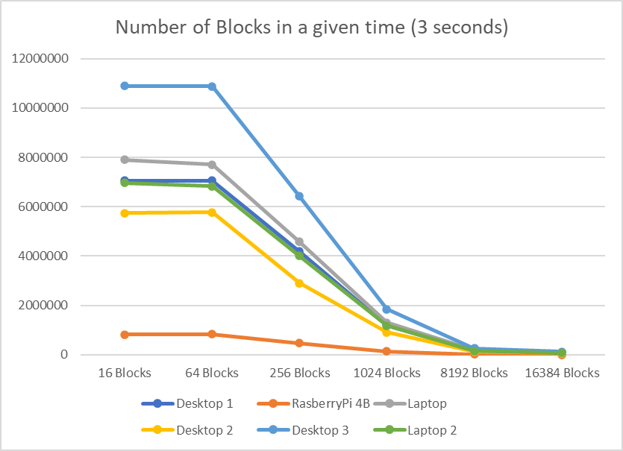
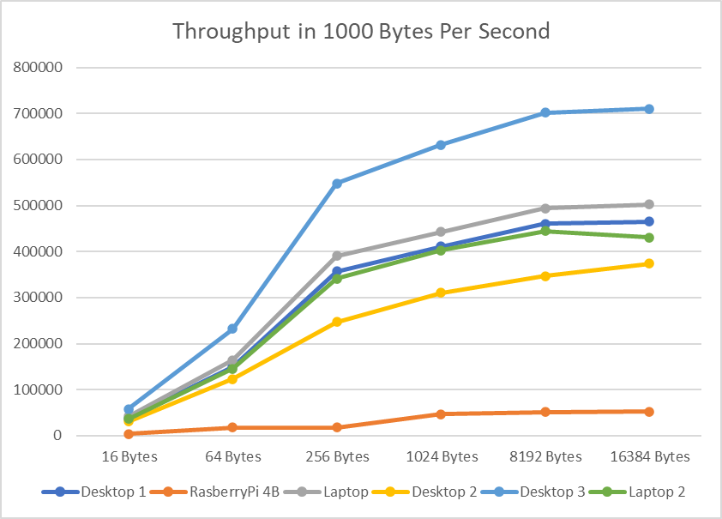
SHA3-256
Highest Performing Processor: Intel i9
Lowest Performing Processor: Raspberry Pi 4 Model B
Built to process 64-bit words
Clock speed has less impact due to less frequent memory access
Higher throughput due to smaller hash output size (256-bit)

Slide 10
Comparing SHA2-256/SHA3-256
SHA2-256
Both algorithms are unique (SHA3 is not an upgraded version of SHA2 algorithm)
Less total number of blocks due to SHA3 algorithm being more complex
Considerable dip in number of blocks from size 16 to 64 on SHA2
Less total throughput on SHA3 due to it being newer so less optimizations
SHA3-256

Slide 11
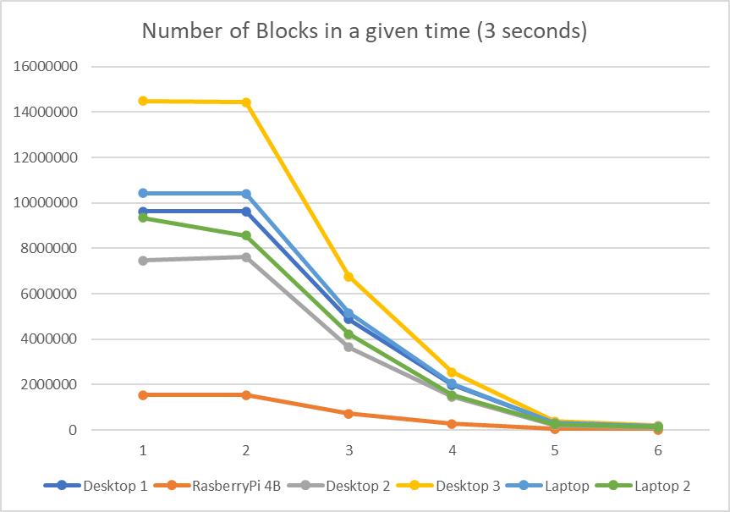
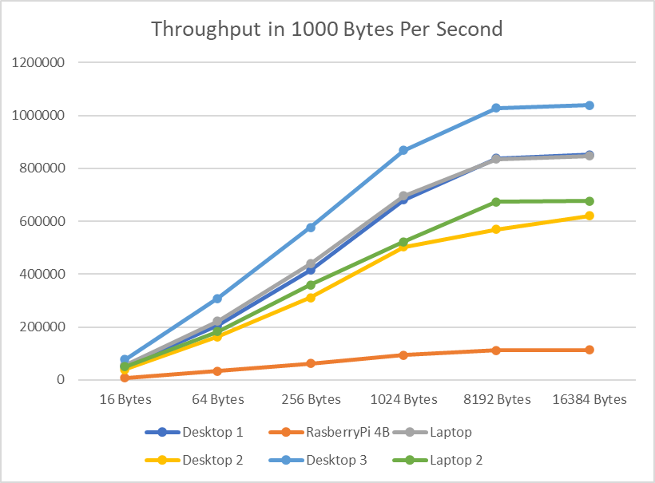
SHA2-512
Highest Performing Processor: Intel i9
Lowest Performing Processor: Raspberry Pi 4 Model B
Built to process 64-bit words
Clock speed has less impact due to less frequent memory access
Lower throughput due to larger hash output size (512-bit)

Slide 12
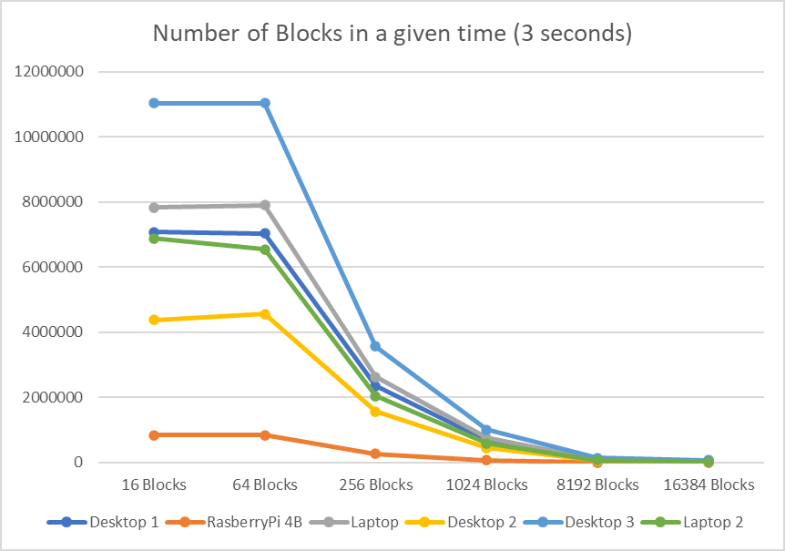
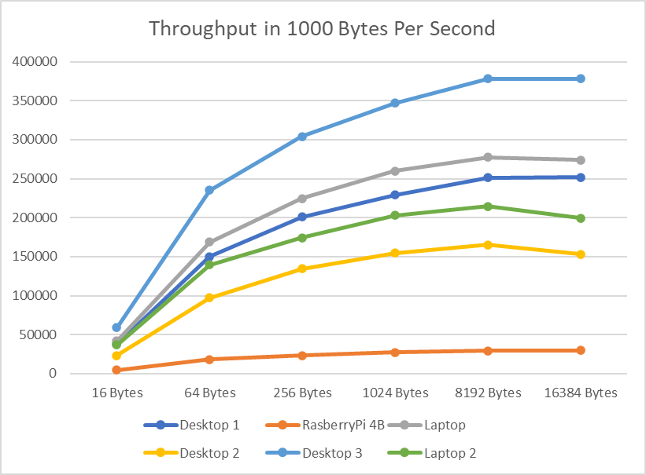
SHA3-512
Highest Performing Processor: Intel i9
Lowest Performing Processor: Raspberry Pi 4 Model B
Built to process 64-bit words
Clock speed has less impact due to less frequent memory access
Lower throughput due to larger hash output size (512-bit)

Slide 13

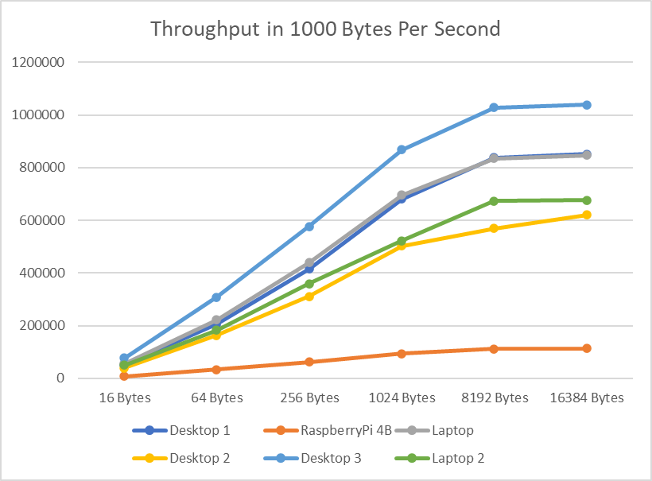

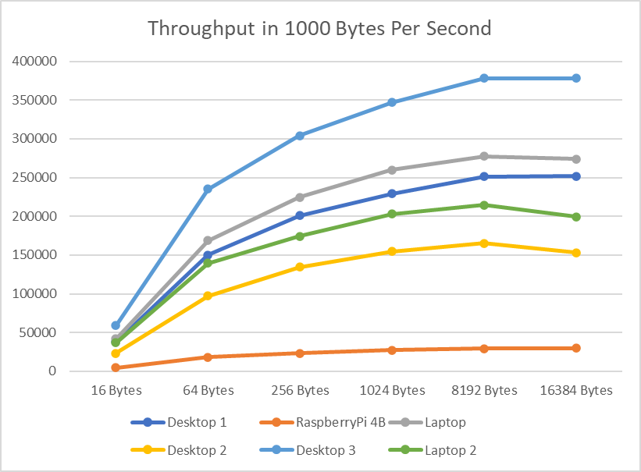
Comparing SHA2-512/SHA3-512
SHA2-512
Similar number of blocks graph due to both of them processing 64 bit-words
SHA3 has less total number of blocks due to the algorithm being more complex than its counterpart.
Throughput increases more linearly in SHA2 algorithm as opposed to SHA3 due to their different constructions.
SHA3-512

Slide 14
Conclusion

Slide 15
Conclusion
The Intel i9-12900K processor (Avesta’s Hardware), coupled with high-speed DDR5 RAM, consistently emerges as the top-performing processor, attributed to its superior clock speed, L2 Cache size, and RAM specifications. Conversely, the ARM Cortex-A72 on the Raspberry Pi 4 Model B (Roberto’s Hardware) consistently performs at the lowest level due to its low clock speed and slower RAM.

